Slide 1


Deep Learning
www.aimlgyan.com
By Vinay Dhimaan

Slide 2

What is Deep Learning?
. Definition: Deep learning involves training artificial neural networks with many layers (hence "deep") to learn representations of data. These networks can automatically learn features from data, making them very powerful for complex tasks.
Analogy: Think of deep learning as teaching a child to recognize objects. Initially, they see many examples of different objects, and over time, they learn to identify them by recognizing patterns.

Slide 3
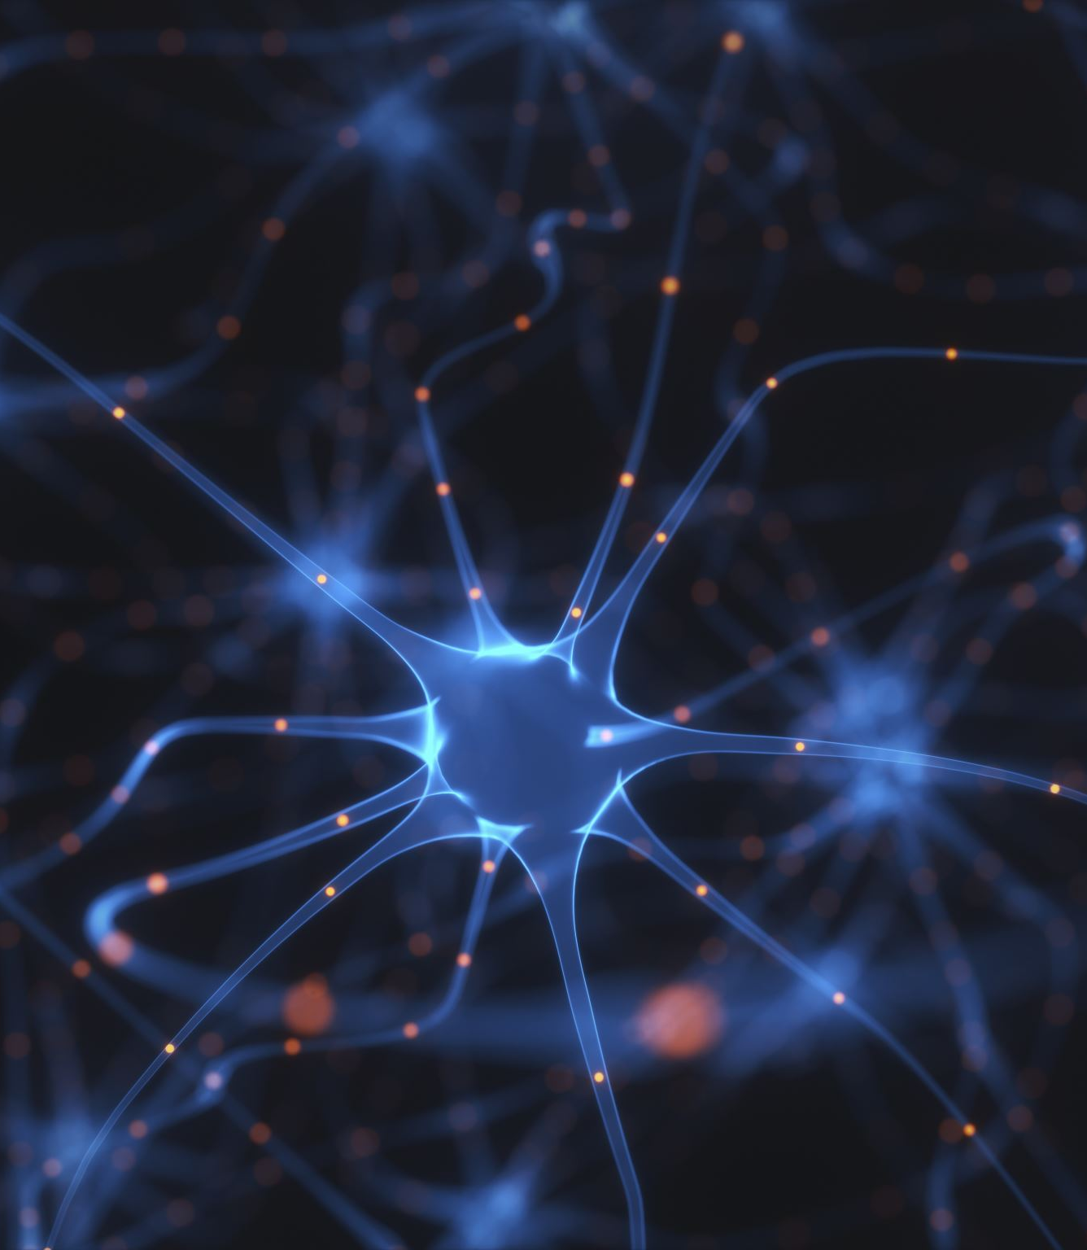
Basic Concepts
Neurons and Layers:
Neuron: The basic unit of a neural network. It takes input, processes it, and passes it on as output.
Layer: A collection of neurons. There are three main types of layers:
Input Layer: Takes in the initial data.
Hidden Layers: Intermediate layers that process the input data.
Output Layer: Produces the final result or prediction.
Activation Functions:
These functions decide whether a neuron should be activated or not. Common activation functions include ReLU (Rectified Linear Unit), Sigmoid, and Tanh.
Weights and Biases:
Weights: Parameters that are learned during training. They influence the importance of the inputs.
Biases: Constants added to the input of the activation function to help the model make better predictions.

Slide 4

How Does a Neural Network Learn?
Forward Propagation:
Data moves from the input layer through hidden layers to the output layer, producing a prediction.
Loss Function:
Measures the difference between the predicted output and the actual target. The goal is to minimize this loss.
Backward Propagation:
Adjusts the weights and biases to reduce the loss. This process is repeated many times to improve the model's accuracy.

Slide 5

Training a Neural Network
Dataset: A collection of data used to train and test the model.
Epoch: One complete pass through the entire dataset.
Batch: A subset of the dataset used to train the model in each iteration.
Optimizer: An algorithm (like SGD, Adam) that adjusts weights to minimize the loss function.

Slide 6
Tools and Frameworks
TensorFlow: A popular open-source library for deep learning.
Keras: An easy-to-use interface for building neural networks, often used with TensorFlow.
PyTorch: Another powerful deep learning library, known for its flexibility and dynamic computation graph.
Summary
Deep learning is about training neural networks with multiple layers to learn from data. By understanding the basic components like neurons, layers, activation functions, weights, and biases, you can start building and training your own neural networks for various tasks. Using tools like TensorFlow and Keras can make this process more accessible and manageable.

